Slide 1
i2i Convening – Geneva June 2017 Findings from the Post Convening Survey

Slide 2
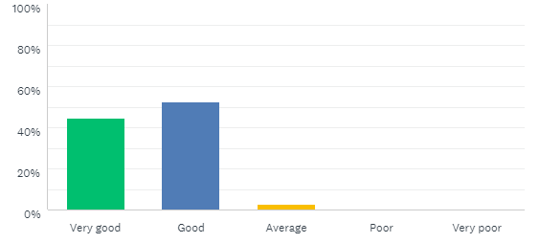
Overall, how would you rate the i2i convening?
73 invites
49 responses
66% response rate

Slide 3
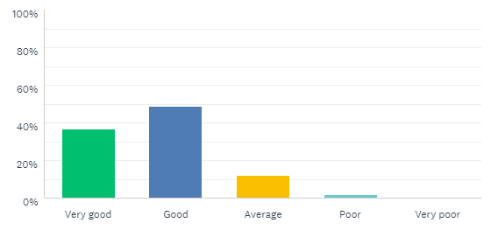
How would you rate the preparation and communication leading up to the convening?
Majority of Attendees felt Pre-Conference communication was Very Good or Good

Slide 4
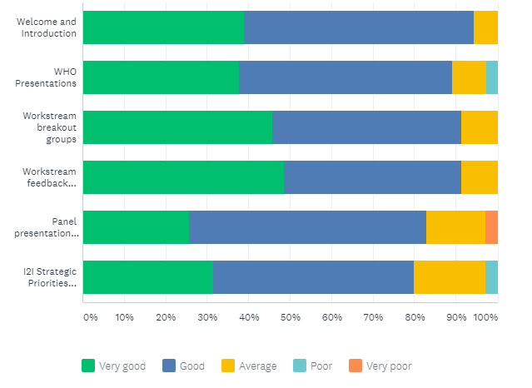
How would you rate the sessions?
Majority of sessions rated
Very Good or Good

Slide 5
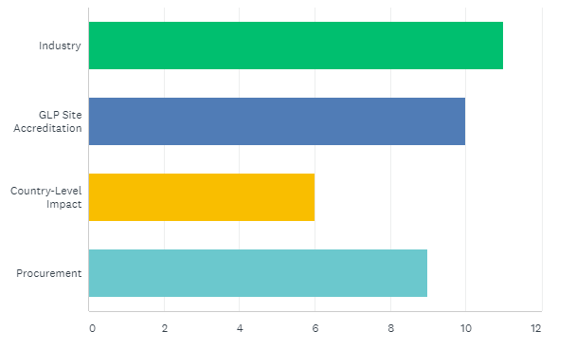
Which workstream breakout session did you attend?

Slide 6
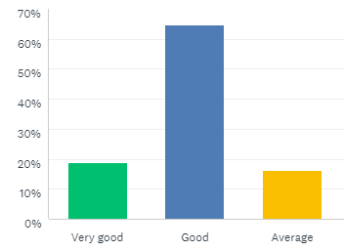
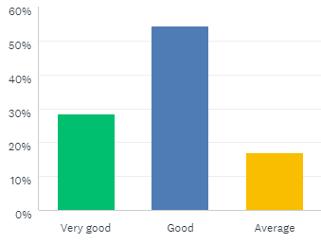
How would you rate the session materials provided?
Pre-Convening Materials
Post-Convening Materials

Slide 7
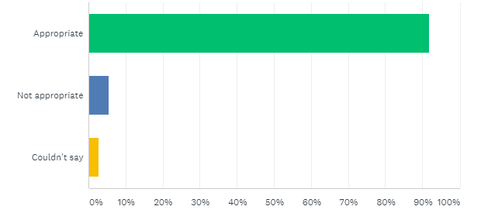
How would you rate the length and format of the convening?
Convening was 1.5 days long
It was split between full plenary and breakout sessions

Slide 8
What should i2i consider doing differently next time?
Key responses from stakeholders:
Need more global country level participation
More discussion time with WHO
Presentation from VCAG
Be clearer on what will happen next
Do cross workstream meetings based on shared issues

